Slide 1


Melbourne Housing Prices Exploratory Data Analysis
By : Timothy Hartanto – A1518246
Notes:
Housing price market dropped by 7% in a year, Torsten Slok chief international economist of Deutsche bank said it was one of the top 30 economic risks of 2019

Slide 2


Background
This Photo by Unknown Author is licensed under CC BY-SA

Slide 3
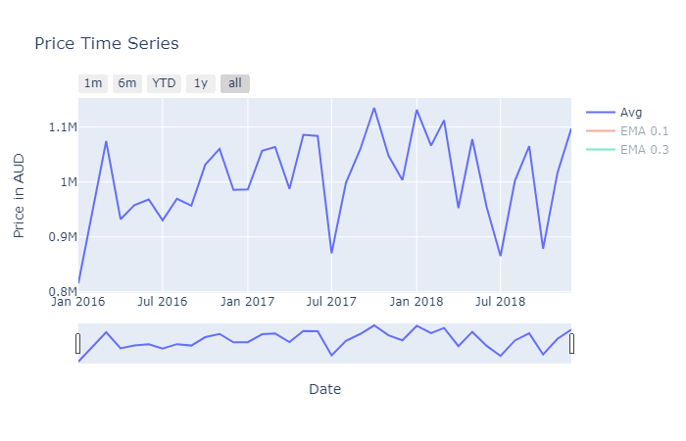

Slide 4
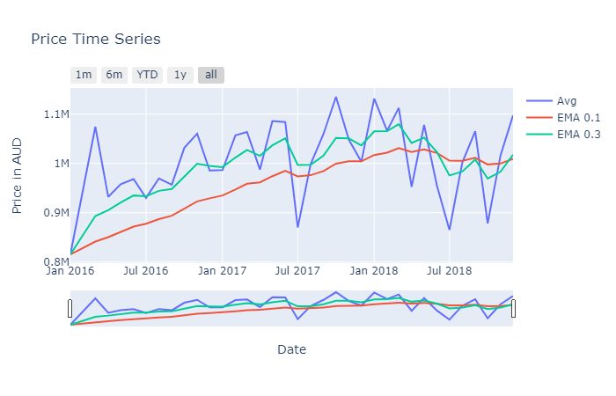

Slide 5
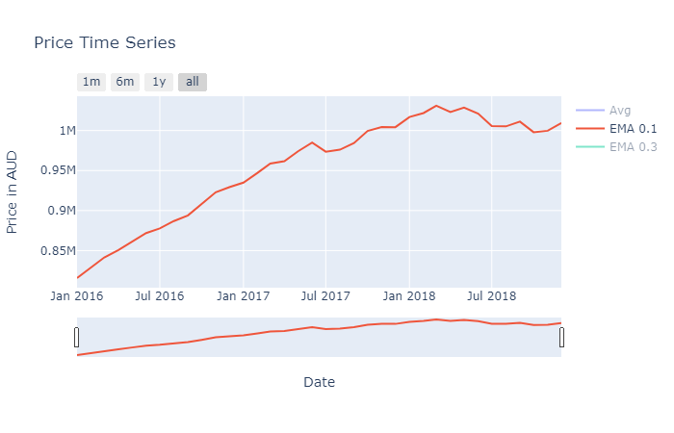

Slide 6
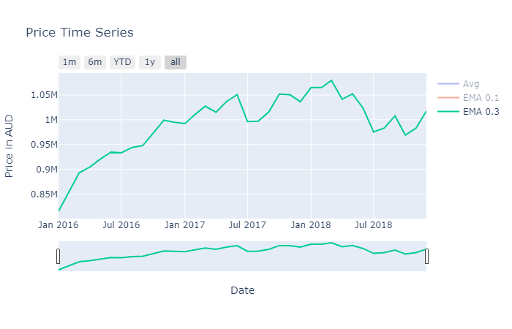

Slide 7
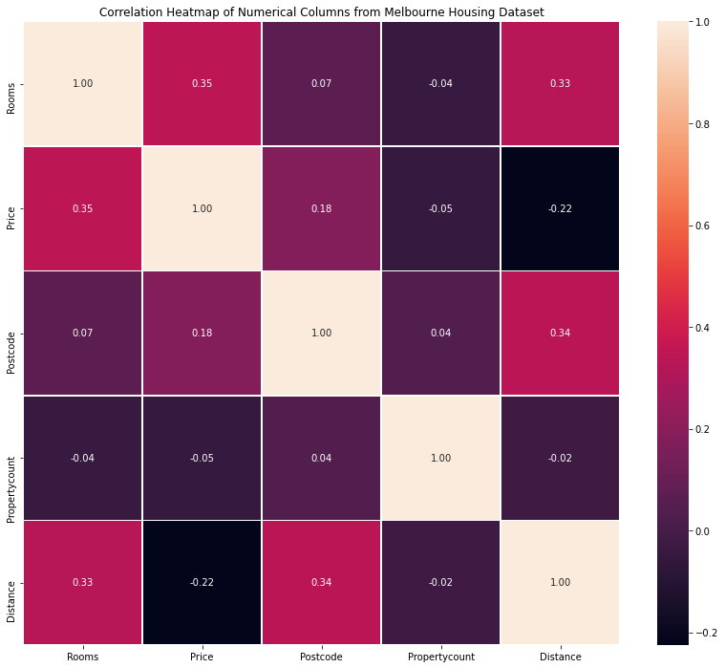

Slide 8

Conclusion

